Slide 1
MTS Sankey Cover Figure
Aug 2017

Slide 2
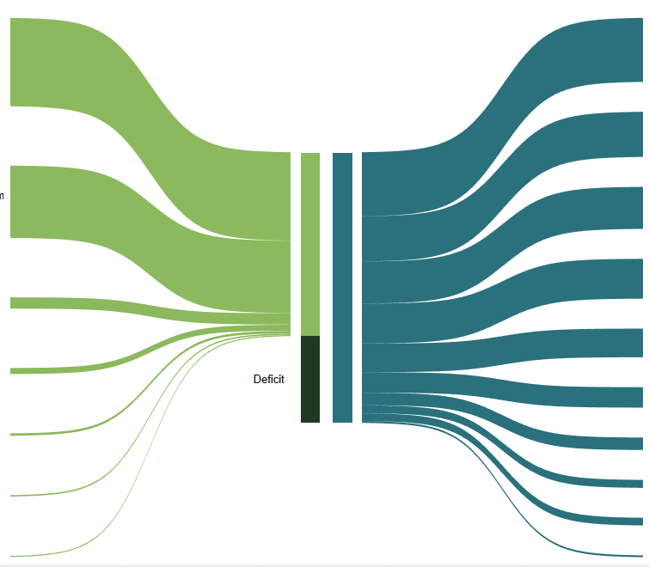
Individual Income Taxes
$79B
Social Security
$109B
$56B
Medicare
Social Security and Retirement Receipts
$104B
$52B
National Defense
$12B
$49B
Health
Miscellaneous Receipts
$35B
Income Security
Excise Taxes
$8B
$25B
Deficit
$25B
Net Interest
Corporation Income Taxes
$6B
$15B
Veterans Benefits and Services
$2B
$10B
Transportation
Customs Duties
$9B
Education, Training, Employment, and Social Services
Estate and Gift Taxes
$2B
$2B
Other

